Slide 1
THE GLEAM TEAM
Andrew Anthony Flores, Massaran Gueye, Katie Kaiser, Leticia Guido

Slide 2





Slide 3

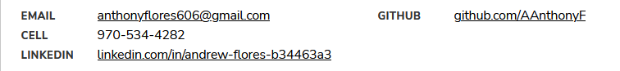

Andrew Anthony Flores
First foray into coding or data science
Most experience comes from retail jobs and management
Currently enrolled in WozU through Southern Careers Institute

Slide 4



2013 - 2017
University of Phoenix
Bachelor of Science:
Healthcare Administration
Katie Kaiser
Medical Background
Currently enrolled in WozU - Entity Academy Data Science Program
Looking forward to using my skills and learning more about data science
How to reach me: Kkaiser1986@gmail.com

Slide 5


2018 - 2020
Bachelor in Arts Double Major:
Mathematics & Economics
Bonjour moi c’est Massaran Gueye ( Sylvie)
Franco Senegalese (France / Senegal)
Speak four (4) Languages: French / Portuguese / Spanish / English
Interested in Cybersecurity
Going forward for my Master’s degree in data sciences with concentration in cybersecurity
Looking forward to collaborate on cybersecurity project which will help me improve my skills
How to reach me: dasygueye@gmail.com

Slide 6

The data set:
https://www.fao.org/livestock-environment/en/
Factors of the highest levels of CO2 during protein production and shipping of commodities
Notes:
Carbon Dioxide : CO2
Green House Gases: GHG

Slide 7
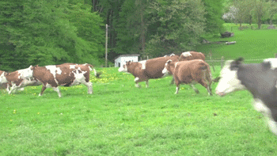
Global demand and production of livestock products are increasing
due to population growth, rising income, and changes in lifestyle and diets.
Livestock systems have a significant impact on the environment, including air, land, soil, water, and biodiversity.
Agriculture’s impact on climate, in the form carbon dioxide for this presentation, can be broken down into commodity, direct energy needs and more.
. The Food Agriculture Organization works to transform and make livestock systems more sustainable, productive and resilient.
Notes:
The reason we all decided to work on this data set is because we all have a genuine interest in our direct impact as consumers!

Slide 8
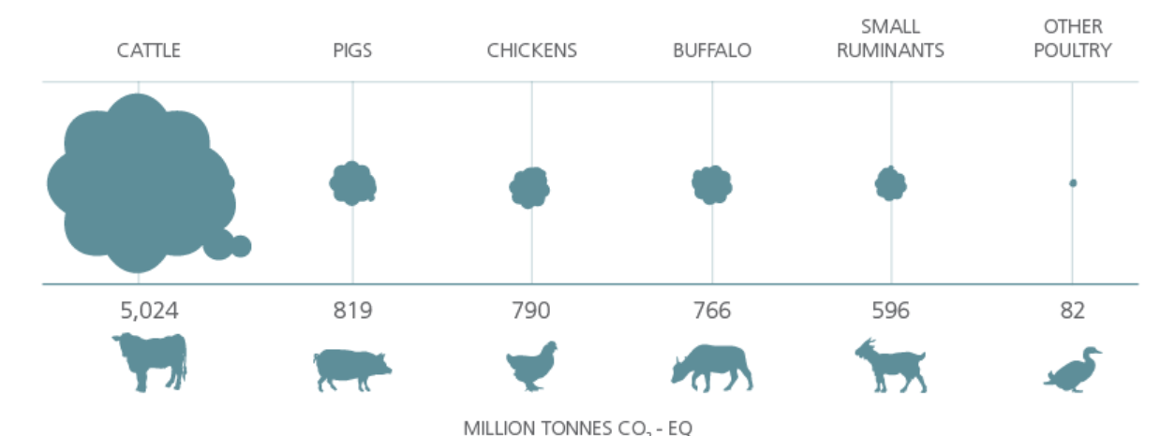
source:https://www.fao.org/livestock-environment/en/
Notes:
Just to give you a visual, we can see that cattle in comparison to other livestock have a much larger footprint.

Slide 9
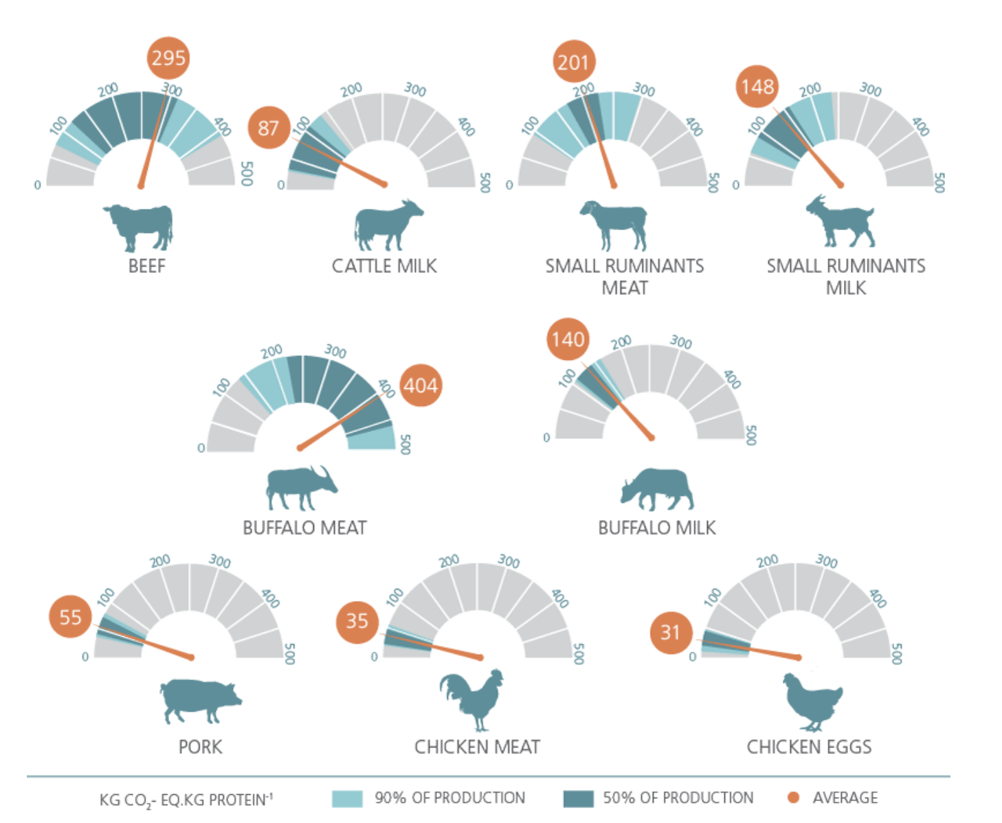
source:https://www.fao.org/livestock-environment/en/

Slide 10
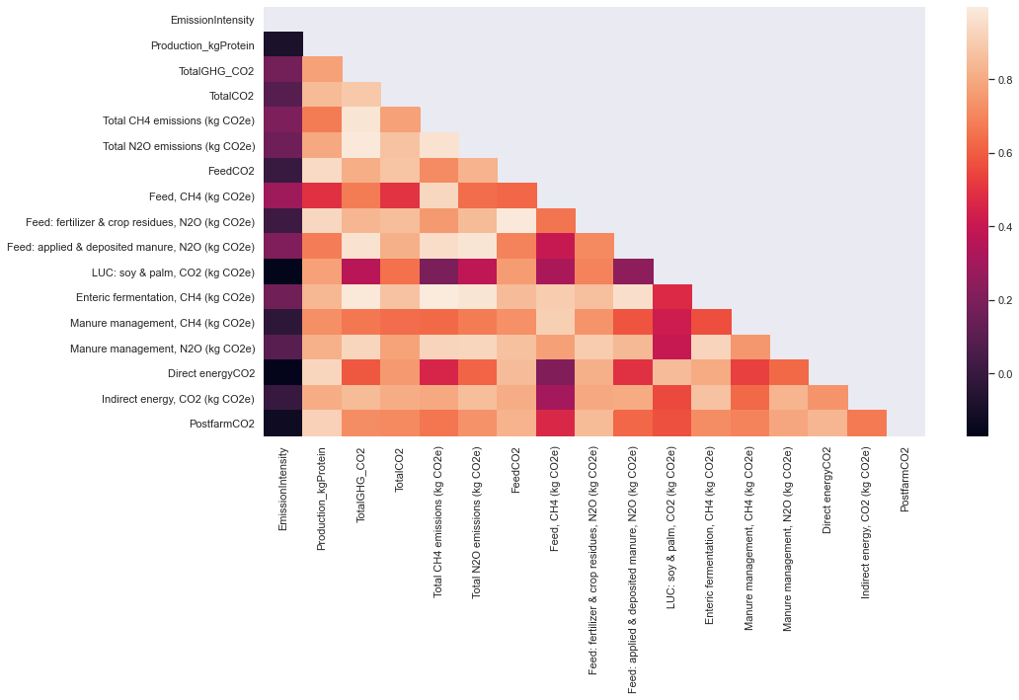
Notes:
Heatmap to help identify possible positive or negative correlations within our dataset. The color of the box is indicative of the strength or weakness of the correlation of data. There are many highly correlated variables and so we decided to create some scatter plots as well as regression lines to elaborate on the relationships. In the following slides, you’ll see some of these relationships.

Slide 11
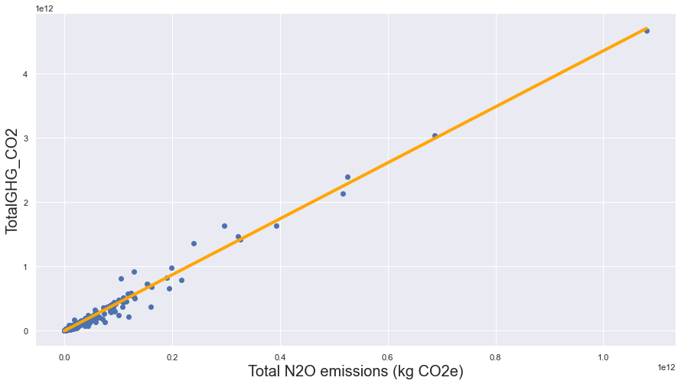
Notes:
Nitrous Oxide emissions from the whole of greenhouse gases.

Slide 12
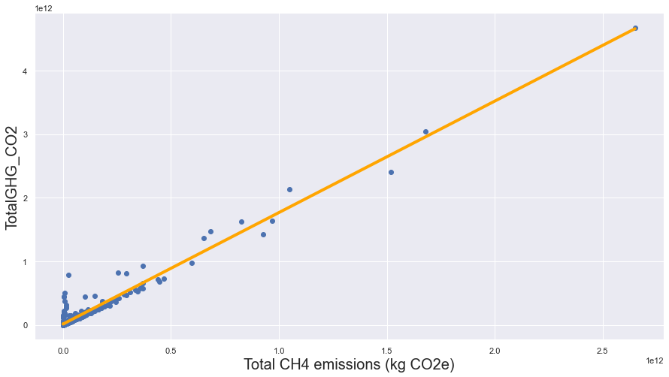
Notes:
Methane emissions from the greenhouse gases

Slide 13
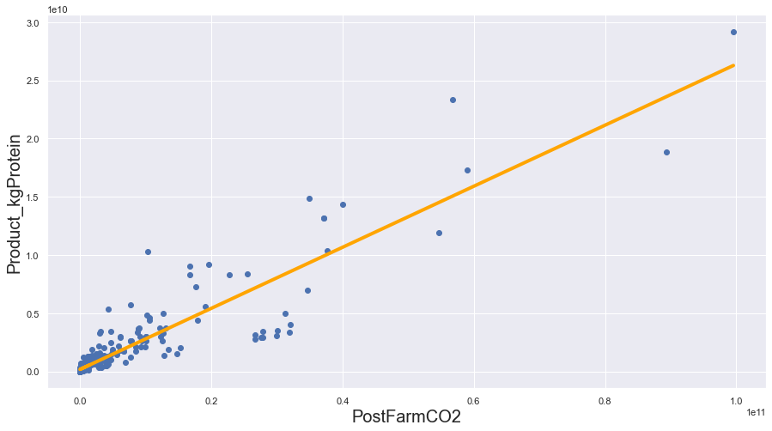
Notes:
Production of protein by kilograms and Post farm carbon dioxide.

Slide 14
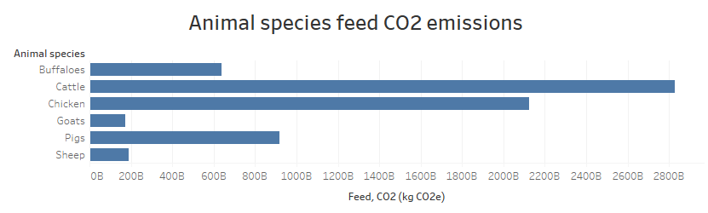
Feed for production CO2 emissions by species
Feed for cattle production is the highest of all the animal species. Let’s see if the commodity type will be indicative of the emissions of CO2.
Cattle produce milk and meat which does drive the need of feed to produce desired amounts of the commodities.

Slide 15
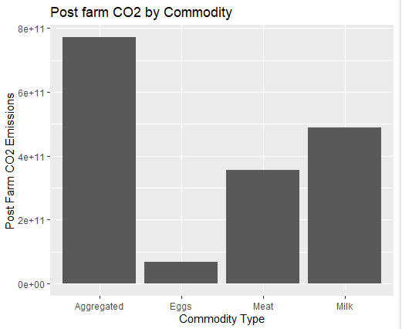
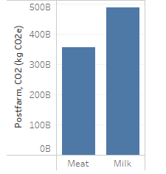
Commodities by post farm CO2
Post farm CO2 emissions are highest for the movement of milk to the marketplace as a single commodity.
This does seem to make sense since milk is a liquid and is also more dense than meat. These emissions are also on a per unit of commodity.
Not all species produce all commodities. The aggregated commodity column is all of the commodities together. This is obviously some redundant information.
We are starting to see a trend that shows a large difference between factors.
Milk and meat are shown since only one animal species is a producer of eggs that are regularly consumed in this data set.

Slide 16
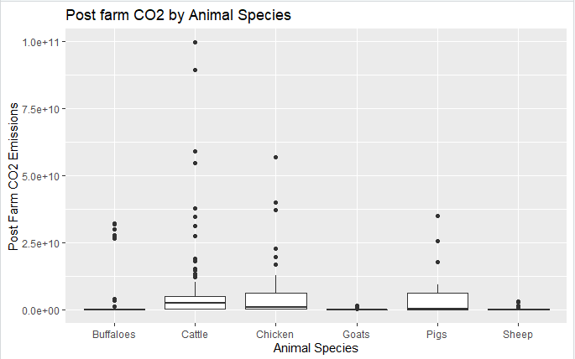
Post farm CO2 and Animal Species emission levels
This boxplot shows levels of CO2
Emissions after the animals have been produced. The process of getting the animals to the market place has its own emissions levels. Greenhouse gas emissions are omnipresent in animal products from farm, feed, and movement to market after production. Cattle leads the way.
Notes:
It should be noted that cattle GHG emissions show to be at higher levels compared to other animal species even with the production of milk as opposed to meat. Buffalo and cattle are similar animals.

Slide 17
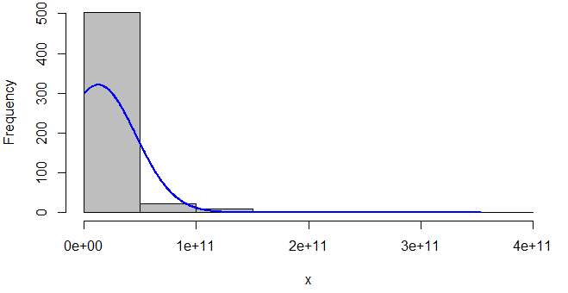
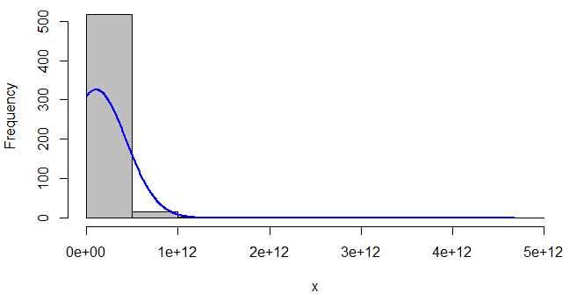
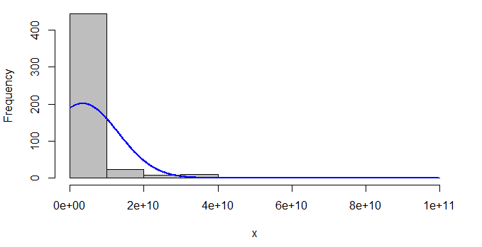
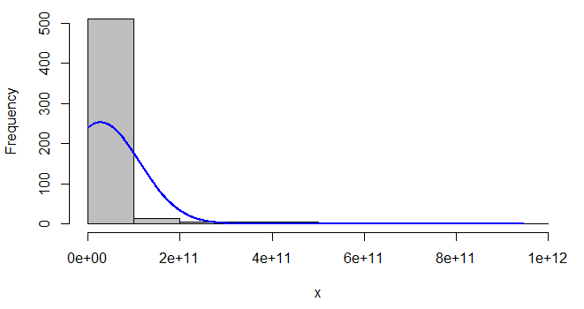
The look of our data.
Our histograms show the same pattern of having a positive skew.
Only 4 were used as a reference and to be more easily seen. This pattern is very consistent across all of our continuous variables.
Notes:
These histograms were done in R Studio.

Slide 18
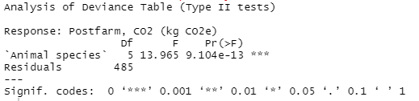
Species and Post Farm CO2
Using Post farm CO2 and Animal species to the analyzation of variance (ANOVA), we find a significant result. This is indicated by the three asterisks. We now know that the animal species and post farm CO2 emissions are strongly related.
This ANOVA was a welcome sight in coding.

Slide 19
Testing the GLEAM dataset
This was the first test to see what next steps should be take. With the error in solve.default, there is not any useful way to shape this data.
The error in solve.default is an indicator that our information being tested will not work. The number in the bottom right of the box is an extremely small number. Nineteen zeros would be in front of that 2.60574. This was a problem several times.

Slide 20
Testing the GLEAM data set (cont.)
Another example of data that is not cooperating. Handling the dataset this way was an obvious dead end.
This time, an even smaller number!

Slide 21
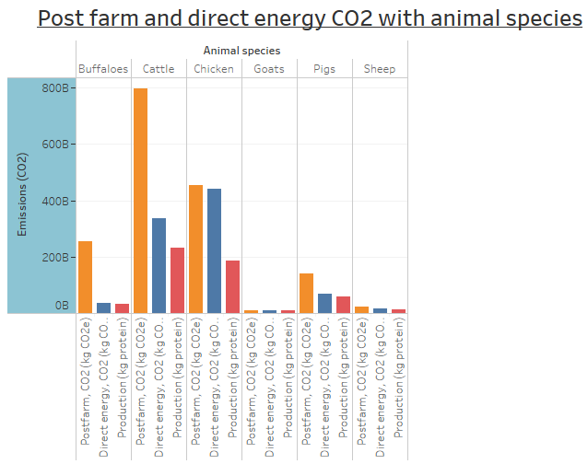
Protein production with Post farm and Direct energy CO2
In red we have the comparative protein production level of each animal species.
Cattle, chicken, and pigs have the highest level of protein production.
The level of CO2 production post farm has the highest overall levels. Production protein appear to be indicators of this level.
Buffalo, with the lower level of protein produced, has a notable level of CO2 emissions.

Slide 22
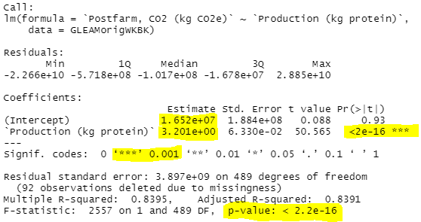
Post farm CO2 and Kg of protein
We have a strong correlation between Post farm CO2 emissions and Production of protein in kilograms.
For every kilogram of protein produced there is a 3.2 unit increase in Post farm CO2 production.

Slide 23
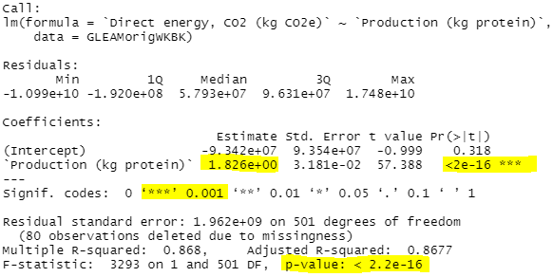
Direct energy CO2 and Protein
The factor of direct energy is being used. This would include heating and cooling of the animals during the commodity production period.
Our direct energy CO2 emissions and protein production also show a strong positive correlation.
Every kg of protein increase in production leads to a 1.826 unit increase in CO2 emissions.
Notes:
The feed that is needed for the animals to produce their commodities would be less flexible to change. Direct energy needs could possibly be supplied by renewable energy or clean energy sources.

Slide 24
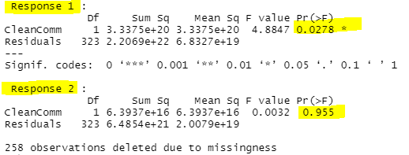
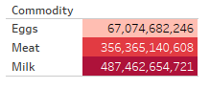
Commodity on Post farm and Direct Energy CO2 emissions
Our first response shows low level significant difference.
Our second response is at 0.955. Nearing 1 is indicative of a high correspondence.
Direct energy CO2 emissions do correspond almost directly with the commodity produced

Slide 25
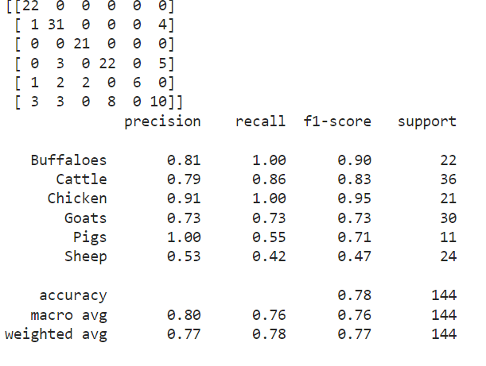
Production System & Animal species
Using all the features besides Production System, a random forest model predicts the correct species 78% of the time. (Buffaloes, cattle, pigs, goats, sheep, chickens).
Random forest model is a nonparametric model, meaning no assumptions need to be met so we can be confident in using this model with these features to predict the correct species of animal

Slide 26
Animal Species Emission Intensity (kg CO2e per kg protein)
Anova test result shows that the difference is very significant between Emission Intensity (kg CO2e per kg protein) and Animal species

Slide 27
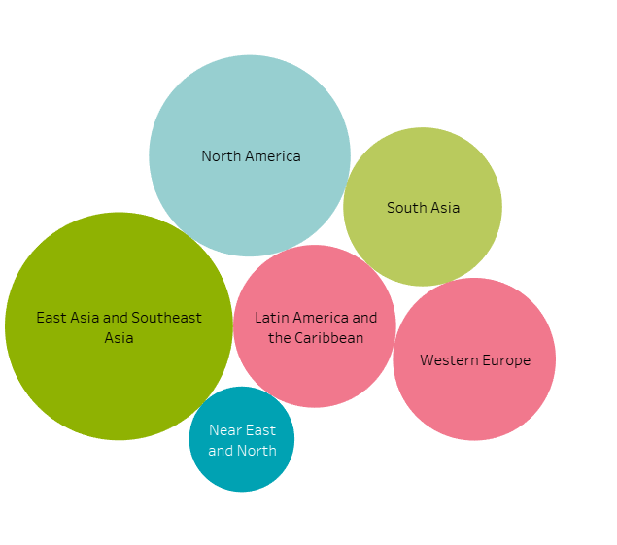
Direct Energy Emissions by Region
Total Post Farm CO2 Emissions
kg CO₂-equivalent
South Asia - 196,418,943,887
North America - 173,680,585,215
Latin America & the Caribbean - 76,298,012,938
East Asia & Southeast Asia - 170,354,530,567
Western Europe - 101,692,609,613
Near East & North Africa - 24,756,521,988
Notes:
Used Tableau and chose the top six to show differences and similarities. Direct energy is emissions use from energy use of heating, ventilation, etc.

Slide 28
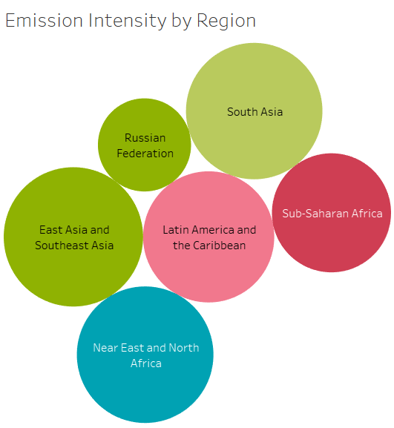
Total CO2 Emissions
kg CO₂-eq · kg protein⁻¹
South Asia - 9,278
Russian Federation - 4,324
East Asia & Southeast Asia - 9,676
Latin America & the Caribbean - 8,574
Near East & North Africa - 9,296
Sub-Saharan Africa - 7,067
Notes:
Used Tableau and chose the top six to show differences and similarities.

Slide 29
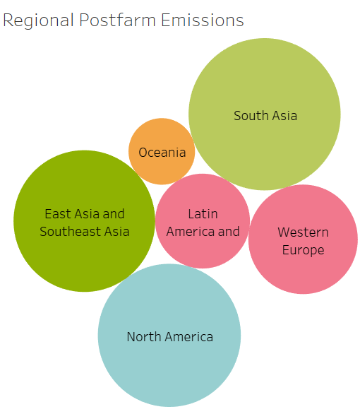
Total CO2 Emissions
East Asia & Southeast Asia - 170,354,530,567
Latin America & the Caribbean - 76,298,012,938
Western Europe - 101,692,609,613
North America - 173,680,582,215
Oceania - 37,606,555,200
South Asia - 196,418,943,887
Notes:
Used Tableau and chose the top six to show differences and similarities. Energy emissions used for processing and transportation of livestock goods after they leave the gate.

Slide 30
Conclusions:
The highest emissions have a tendency to be much higher than the next.
The highest emissions of CO2 after farm production come from milk when getting the milk to the consumer.
Kilograms of protein produced is indicative of the CO2 emissions that will be created.
The protein type being produced does strongly correlate with the emissions from the direct energy needs of farm production in the form of CO2.
We can use these focusing factors to potentially reduce the CO2 footprint of protein production and supply.
World regions have differing challenges to produce and supply livestock

Slide 31
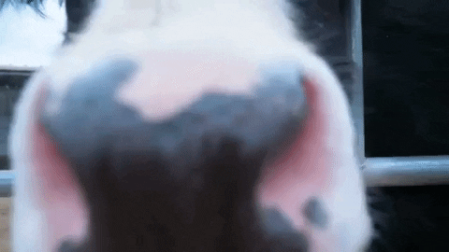
Get a little nosey. Questions for GLEAM

Slide 32
References
Live Stock and the Environment
GLEAM_Data_public_release.xlsx
https://www.fao.org/livestock-environment/en/

